Slide 1
Building Smart Applications
Salesforce, R, Wave - toolset for the pragmatic data scientist
Stanislav Georgiev
Lead Data Analyst
sgeorgiev@salesforce.com
@SgeorgievBG

Slide 2
Safe Harbor
Safe harbor statement under the Private Securities Litigation Reform Act of 1995:
This presentation may contain forward-looking statements that involve risks, uncertainties, and assumptions. If any such uncertainties materialize or if any of the assumptions proves incorrect, the results of salesforce.com, inc. could differ materially from the results expressed or implied by the forward-looking statements we make. All statements other than statements of historical fact could be deemed forward-looking, including any projections of product or service availability, subscriber growth, earnings, revenues, or other financial items and any statements regarding strategies or plans of management for future operations, statements of belief, any statements concerning new, planned, or upgraded services or technology developments and customer contracts or use of our services.
The risks and uncertainties referred to above include – but are not limited to – risks associated with developing and delivering new functionality for our service, new products and services, our new business model, our past operating losses, possible fluctuations in our operating results and rate of growth, interruptions or delays in our Web hosting, breach of our security measures, the outcome of any litigation, risks associated with completed and any possible mergers and acquisitions, the immature market in which we operate, our relatively limited operating history, our ability to expand, retain, and motivate our employees and manage our growth, new releases of our service and successful customer deployment, our limited history reselling non-salesforce.com products, and utilization and selling to larger enterprise customers. Further information on potential factors that could affect the financial results of salesforce.com, inc. is included in our annual report on Form 10-K for the most recent fiscal year and in our quarterly report on Form 10-Q for the most recent fiscal quarter. These documents and others containing important disclosures are available on the SEC Filings section of the Investor Information section of our Web site.
Any unreleased services or features referenced in this or other presentations, press releases or public statements are not currently available and may not be delivered on time or at all. Customers who purchase our services should make the purchase decisions based upon features that are currently available. Salesforce.com, inc. assumes no obligation and does not intend to update these forward-looking statements.

Slide 3

Introduction to Problem, Approach and Solution
Problem - Sales team leader and I need to find out targeted accounts for my new hires in North-West-US. We know that cross-sales is usually a good way of starting out to learn about the business.
Approach - Run a market-basket analysis on our existing Customers in North-West-US to discover Product cross-sales opportunities
Solution - Wave application for Sales leadership to review data finding and set course of action for our new hires
Notes:
Ask people how they would try it out

Slide 4

About me
Good morning everyone, I’m Stan!
Professional Background
Lead Data Analyst
Product Manager Data Platform
Product Manager Business Intelligence
Data Operations Analyst
Bachelor in Applied Mathematics
Notes:
Picture / Certifications
3rd year at Dreamforce and decided that is finally time to join the action
Excited to show you a quick and fun way to build awesome application for your team.
CDMP, #130687

Slide 5
DEMO: Final application goals
{ Link }
What products are we trying to sell?
How many Customers?
How many people do I need?
Notes:
Ask people how they would try it out

Slide 6

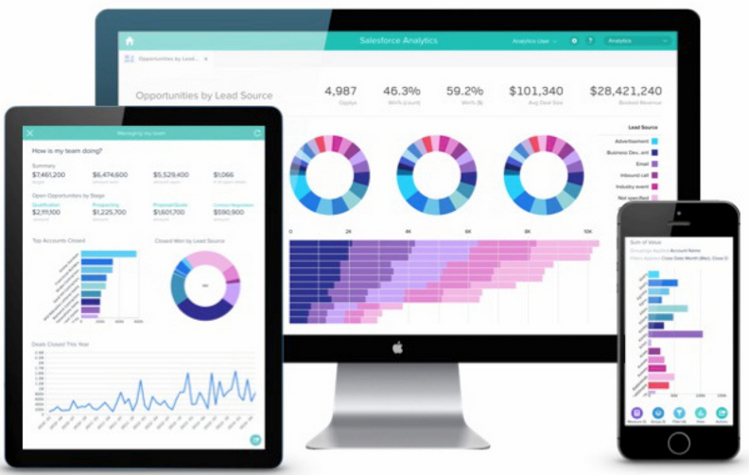
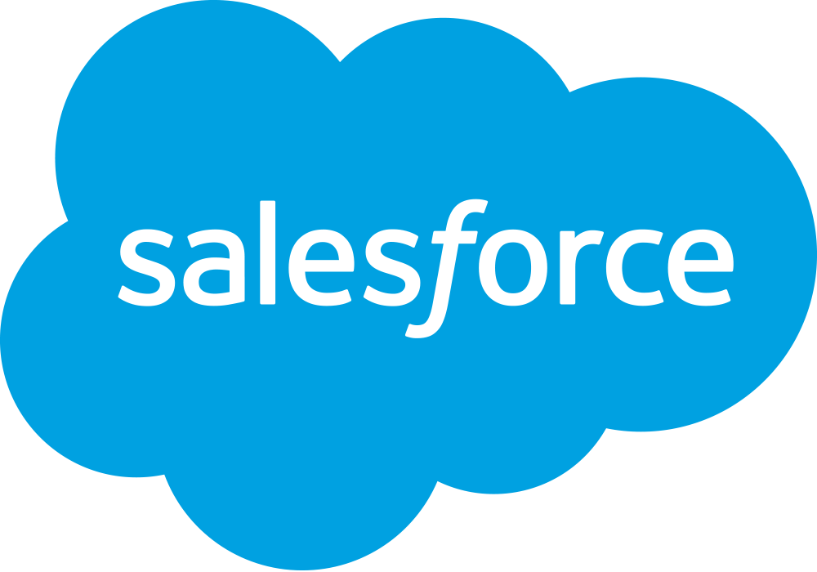
What do we leverage each component for?
Reach everyone in the Org
Multiple Applications
Consolidate data silos
Business Strategy
Historic Information
Feedback loop
Computational environment
Data clean-up / preparation
Mining, Modeling
Notes:
Gather Customer information from Salesforce {CRM}
Apply the Apriori algorithm to identify upsell & recommendation targets {R}
Build a smart Wave-app for our Sales leadership team {Application}

Slide 7













Salesforce is Powered by the Salesforce1 Platform
Common data model, workflows, and collaboration. Built for desktop and mobile.
Complete CRM
Sales
Service
Marketing
Community
Analytics
Apps
Cloud
Mobile
Social
Data Science
Largest Enterprise Ecosystem
2,700+ Partner Apps
Flexible, Scalable, Metadata Platform
Data & Objects
Mobile UI
Workflow
APIs
Collaboration
Analytics
Identity
Fast App Dev & Customization
Trusted Multitenant Cloud
Notes:
The secret sauce is that all of these processes – these apps – all share a common platform… the Salesforce1 Platform. And that means they inherit all the same technology, tools, and benefits of the platform.
It all starts with Salesforce’s secure multitenant cloud, which is trusted by thousands of companies in every industry from financial services to manufacturing, comms, retail, healthcare and even governments. The multitenant model is a bit like an apartment building, where the building provides all of the plumbing, electricity, and other services, but each tenant is separated from other tenants, and has the flexibility to make their space their own.
On that solid base we provide powerful customization and app dev tools that help developers focus on innovation instead of infrastructure, and even bring point and click development to business users. And because all of the development and customization is at the metadata layer, it is logically separated from underlying salesforce cloud, and that means when there is an upgrade to the cloud platform itself (which happens 3x a year), everything you’ve built or customized gets that upgrade without a hitch – no data migration required, and nothing breaks.
The apps themselves – whether it is our CRM apps or your own - are connected to each other with a common set of core platform services – a common data model, UI framework, collaborative layer, embedded reporting and dashboards, workflow that spans across groups, and a common identity. And every desktop app is automatically available on mobile through the salesforce1 mobile app. And finally, everything is instrumented with APIs to work with your existing systems.
Salesforce has a massive ecosystem of partners that are building on this platform as well – apps right out of the box for your business.
(And Salesforce uniquely offers both the power of the Force.com enterprise platform for your business processes with the flexibility of the Heroku elastic platform for your customer engagement.)
When you add this all up, it means you have everything you need to focus on your business and driving engagement with your customers instead of figuring out how to connect it all and make technology work for you. This is why Salesforce has become the world’s #1 CRM.

Slide 8
R - Statistical computing
Trusted and tested package repository
CRAN - The Comprehensive R Archive Network
Most everything and lots of was first / originally written for R
Continues to evolve and more general framework vs. statisticians only
Large existing community
http://www.inside-r.org/
http://www.r-bloggers.com/
Tested by times
20 years+ of existence, based on S which is nearing 40 years of existence
C, C++, Fortran code linked at run-time behind some of the faster library’s secret
Notes:
S is a statistical programming language developed primarily by John Chambers and (in earlier versions) Rick Becker and Allan Wilks of Bell Laboratories. The aim of the language, as expressed by John Chambers, is "to turn ideas into software, quickly and faithfully".
End: While R has a lot of libraries that can also chart, we are going to break away from the nerdy and go back to engaging our users with Wave

Slide 9


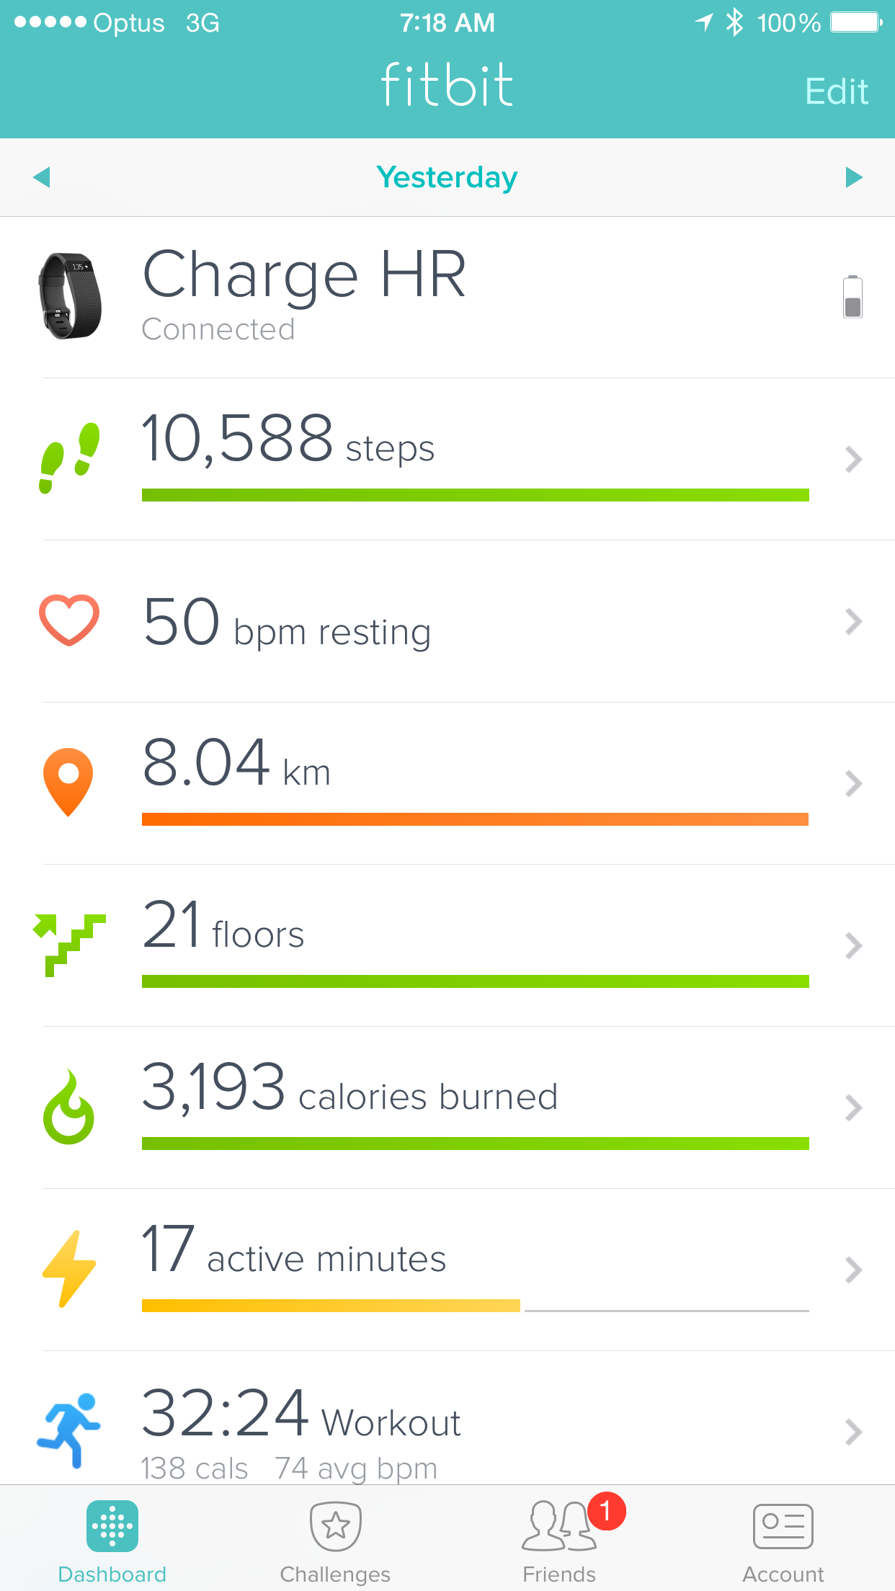
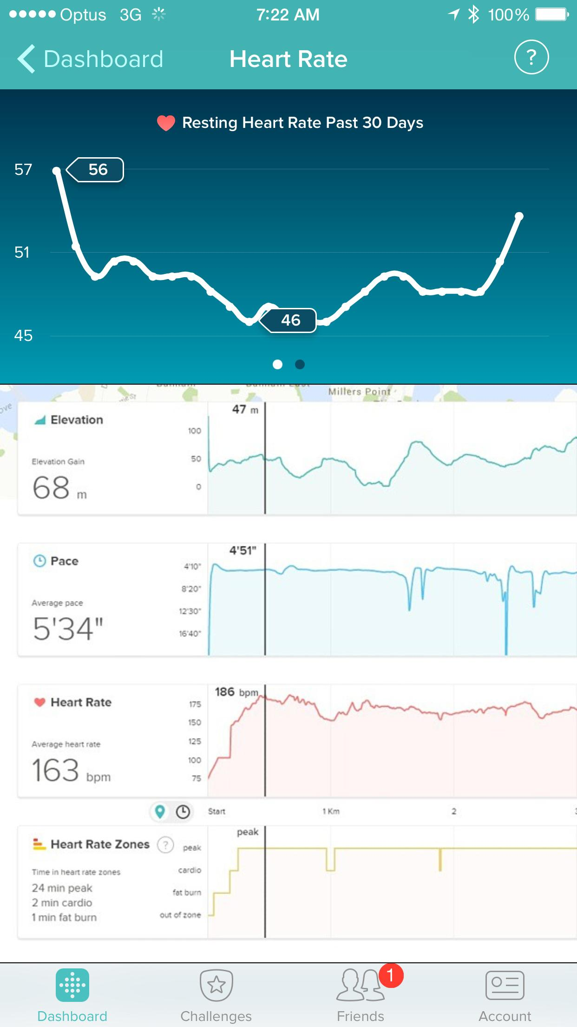
Data is ubiquitous today

Slide 10





But Legacy Business Analytics are Disconnected
Restricted to Experts
Scattered Spreadsheets
Desktop-Only Business Intelligence
Not complete
Not mobile
Not customized
Not actionable
Not in the cloud
Ask questions and email
Limited availability
Slow response time
Inaccurate analysis
Static data
Poor data quality
Disconnected systems
Hard to Use
Not Mobile

Slide 11


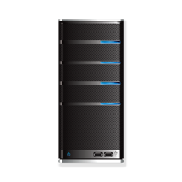


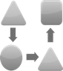



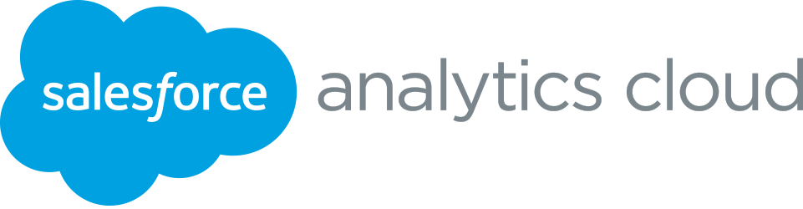
Salesforce Analytics Cloud: The Fastest Path to Insight
Legacy Business Analytics
Slow, On-Premise, Disconnected
Data
EDW
Data Marts
BI Platform
Discovery Tool
Run Reports
Excel & PPT
Sharing
Insight
Data
EDW
Native Salesforce Integration
Multi-party data
Search-based query engine
Schema free
Visualization
Collaboration
Mobile
Insight
Notes:
With all of this in the Analytics Cloud – the Analytics Cloud is the fastest path to insight. Whereas legacy BI is slow, on-premise and disconnected from the business user, Analytics Cloud gets data and insight into the hands of your business.
Legacy BI – Steps to Insight: Time consuming, massive commitment to do a single project
1) Bring data into a data warehouse
2) Provision data marts and organize data into schemas
3) Layer on a BI platform do analysis
4) Layer on a Discovery tool for analysts to be able to visualize and explore analysis
5) Run reports
6) As needed, export to Excel and PowerPoint
7) Email to the business
If Business has a new question, business use must log a ticket to get an email from an analyst (often many hours to many days)
Analytics Cloud: Very fast time to value for each products, flexibility to make changes to align with your business
Data pushed into the Analytics Cloud from the Enterprise Data Warehouse or directly from the source
Data is ready to explore and navigate by the business user, from any device
Simultaneously, analysts and business users can build dashboards and share across the wider organization

Slide 12
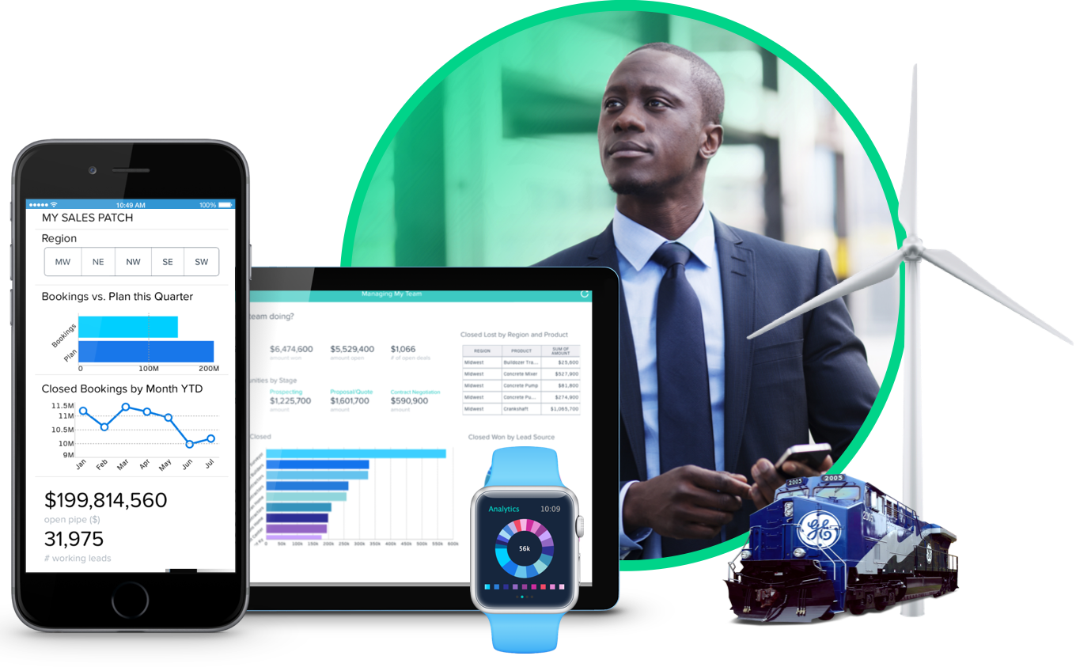














Analytics Cloud: Analytics for the Rest of Us
Powered by the Wave Platform
Everyone gets answers faster than ever
Mobile insight on any device
Platform for any data, any app
Self Service
Collaboration
Exploration
Analytic Apps
Search Based
Any Data
Extend the Platform
Governance & Trust
Notes:
Analytics Cloud: Analytics for the rest of us
Everyone can get answers faster than ever. No data science degree required, no more logging tickets to access your answers.
Mobile: Distributed workforce can now get answers right from your phone, no more running back to your desktop.
Platform for any data, and any app. Structured and unstructured data are seamlessly brought into the Wave platform. The wave platform is Schema-free and is not built with a relational database – making it easy to connect the right data, faster than ever.

Slide 13
Market Basket Analysis
Smart (~5-10min)
Notes:
http://www.slideshare.net/DerekKane/data-science-vi-association-rule

Slide 14

Market Basket Analysis
Products
C and D
65%
Products:
A and B
Product:
E
32%
Products
C & E
18%
RHS - Right Hand Side
(Products Customer already owns)
LHS - Left Hand Side
(Products we will reccommend)

Slide 15
Association rules learning
A method for discovering interesting relations between variable in large datasets. It is intended to identify strong rules discovered in datasets using different measures of interestingness.
A rule is most often written is this form, { A, ... } => { B }
where the { A, B,... } represents the left hand side, LHS, of the rule and the { B } represents the right hand side, RHS
e.g. 65% of people who bought itemset A & B, have also bought E 32% of the time
Notes:
Association rule learning is a popular and well researched method for discovering interesting relations between variables in large databases. It is intended to identify strong rules discovered in databases using different measures of interestingness.^{[1]} Based on the concept of strong rules, Rakesh Agrawal et al.^{[2]} introduced association rules for discovering regularities between products in large-scale transaction data recorded by point-of-sale(POS) systems in supermarkets.

Slide 16

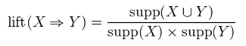
Important terminology and definitions
Measures of significance and interest
% on the field
eg. 65%
vs. coin toss
Support
Confidence
Lift
The support value of X with respect to T is defined as the proportion of transactions in the dataset that contains the itemset X.
The confidence value of a rule, , with respect to a set of transactions T, is the proportion the transactions that contains X which also contains Y.
The ration of the observed support to that expected if X and Y were independent.
Notes:
Support - The fraction of transaction containing the item-set of interest. bread was found in 2 out of the 10 trasactions
Confidence - {butter, bread} => {Milk} = 1, meaning that Customers who bought bread and butter always bought milk as well. Suggest strong co-occurrence, should not be mistaken with causality
Lift - Confidence of a rule exceed our expected confidence

Slide 17
Lets walk through the code
RForcecom - R library to retrieve Customer purchasing information
DataUtil.jar - Java executable to integrate into Wave
Dataset preparation step goal is to reach ‘transactions’ format in the form of CustomerID : {Product-List}
Application of Apriori algorithm on the transaction dataset to extract rules
Dataset preparation for for Wave e.g. append our rules to the Customer Dataset
Notes:
Add visuals & links to both places

Slide 18
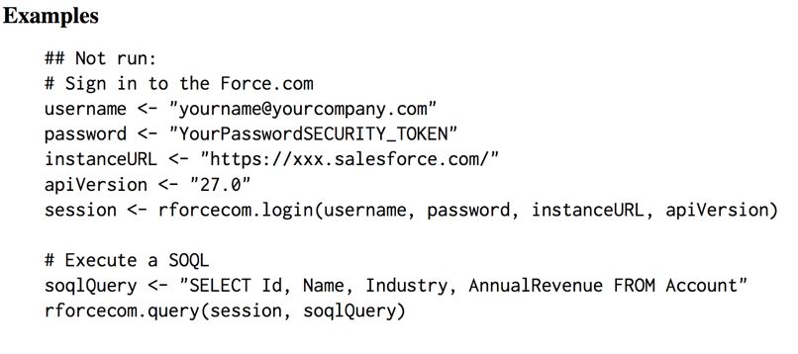
How to move the dataset from Salesforce to R?
Library - https://cran.r-project.org/web/packages/RForcecom/index.html
Documentation - https://cran.r-project.org/web/packages/RForcecom/RForcecom.pdf
Notes:
Enterprise Datawarehouse

Slide 19
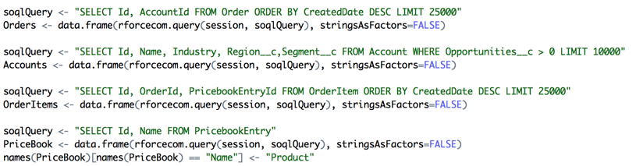
Now that we are connected… lets see what is inside
Order
Accounts (Details)
Order Item
PricebookEntry

Slide 20
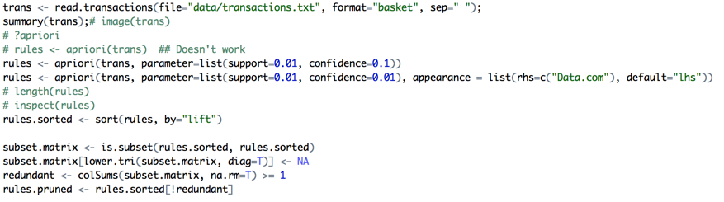
Association rules extraction

Slide 21
What are some of the rules we learned?

Slide 22
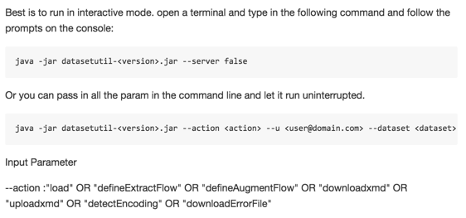
How to move the dataset from R to Wave?
https://github.com/forcedotcom/Analytics-Cloud-Dataset-Utils

Slide 23
Back to Wave
Application (10-15min)

